Slide 1
JAVA Basic Concept
Sarower Ahmmed

Slide 2
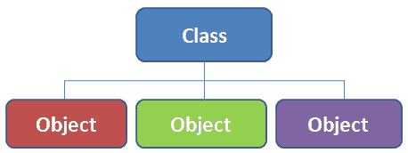
Class
Collection of objects is called class. It is a logical entity.
Its blue print of objects
It is a logical entity.
It can't be physical.

Slide 3
Project> src/test/java or src/main/java> package>class
Project
Top most
packages
Collection of classes
Class
Blueprint of object

Slide 4
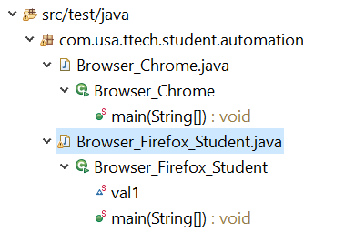
Inside folder: How to create a class in Eclipse project ?
Package
.java file /class code
.class file/ after compiler
Method
Variable

Slide 5
Create class in Code level
package com.hakerrank;
public class Animal {
}

Slide 6
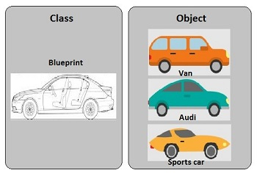
Object/Class -Instance in JAVA
Object is a instance of class
Real world substance
It’s a part of class

Slide 7
Difference between object and class
OBJECT | CLASS
Object is an instance of a class | Class is a blueprint or template from which objects are created.
Object is a real world entity such as pen, laptop, mobile, bed, keyboard, mouse, chair etc. | Class is a group of similar objects.
Object is a physical entity. | Class is a logical entity.
Object is created through new keyword mainly e.g. Student boy=new Student(); | Class is declared using class keyword e.g. class Student{}
Object is created many times as per requirement. | Class is declared once.
Object allocates memory when it is created. | Class doesn't allocated memory when it is created.
There are many ways to create object in java such as new keyword, newInstance() method, clone() method, factory method and deserialization. | There is only one way to define class in java using class keyword.

Slide 8
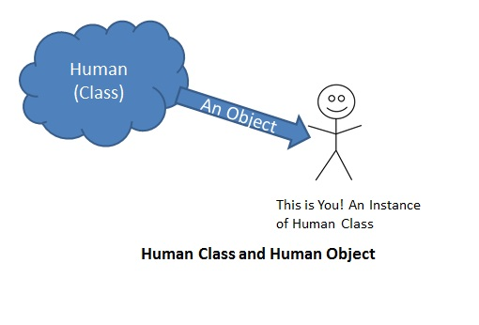
How to create a object /instance of a class??
Formula::ClassName object = new ClassName();
If your class name is Human and
Formula:: Human object = new Human();
If you want object name man
Formula:: Human man = new Human();
If class name Login and object is obj
Formula:: Login obj = new Login();
Man/woman
Man/woman= object

Slide 9
Method in JAVA
Method is a set of statements to perform an operation,
methods are also known as procedures or functions.
A method is a group of Java statements that perform some operation on some data, and may or may not return a result.
Example : System.out.println() >> print() method
the system actually executes several statements in order to display a message on the console.

Slide 10
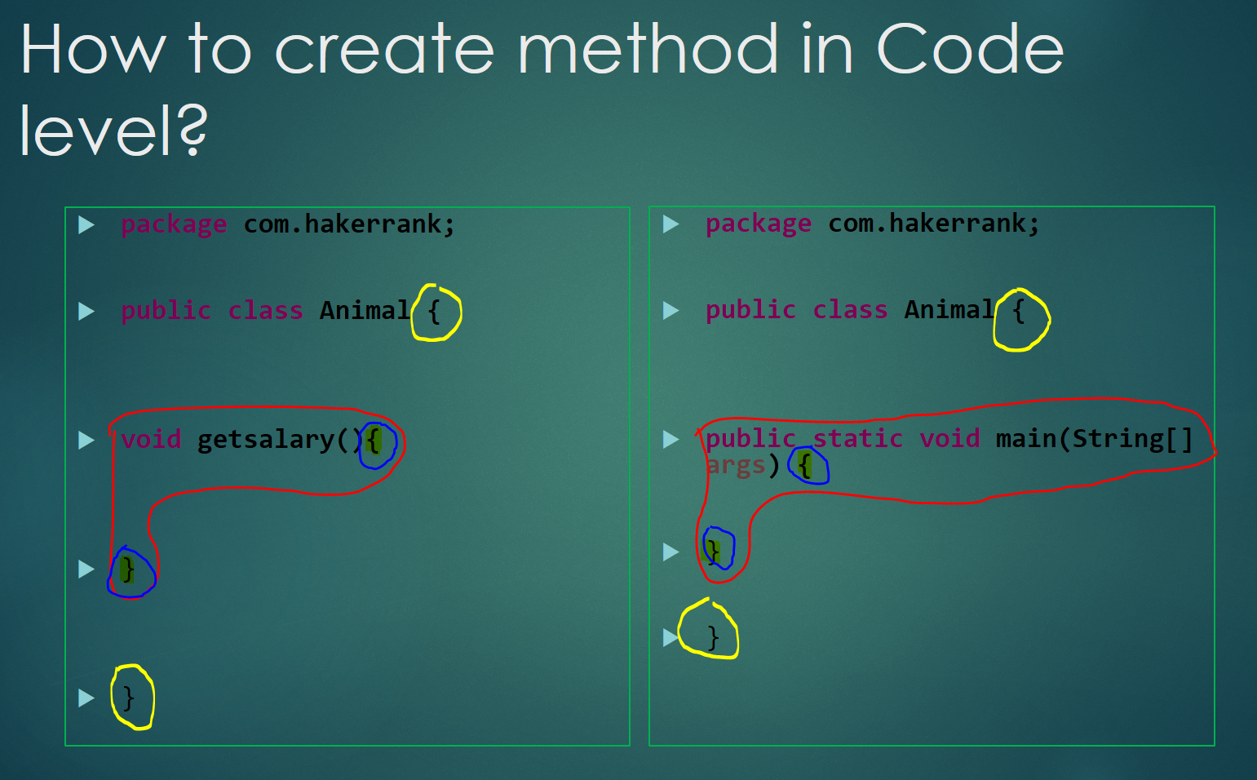
Yellow is class curly bracket
Blue is Method curly bracket

Slide 11
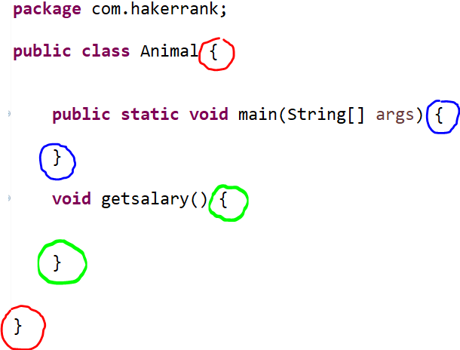
Red = class , Blue =1st method , Green= 2nd method

Slide 12
Method in JAVA
A method- contains
Method signature /name
Method description / body
Method parameter or argument
package com.test;
public class Animal {
void getsalary() {
}
}
Method
getsalary =name of method
Area between {
Body
}
() = parameter or argument area and inside need to pass parameter
Parameter or argument

Slide 13
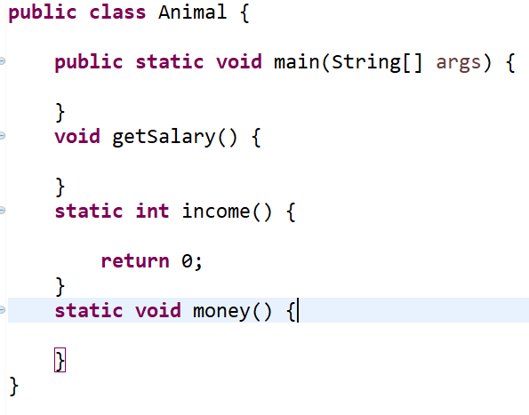
Methods type in java
Main method
Void
Static

Slide 14
Void= return nothing static = return something
Main | void | static
JVM understand | Not | Not
Code execute | Not | Not
Not return any value | Not return any value to use in main method | Return value to use in main method
Static , so its class level | Void is a object level not class level | Static , so its class level
Can handle static methods or variable | Handle instance variable | Handle static variable

Slide 15
Example of main method
class TestDemo1 {
public static void main(String args[]) {
your code here
}
}
JVM only understand main method
All code run or execute from only main method
Main method is fixed , we cant change any word from main method
Even cant change name from main to other words – than code will not run

Slide 16
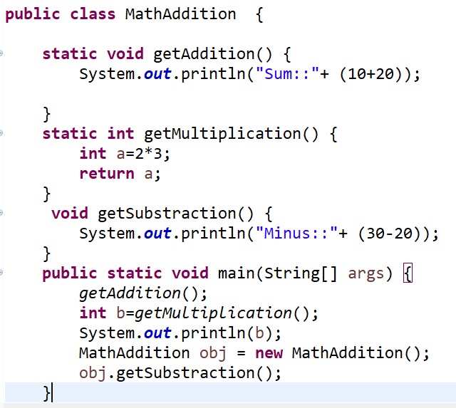
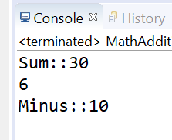
If main method only run code than why need other methods?

Slide 17
Why need other methods?
We can write code in any methods
Than call all method inside main method >>> run the code & all value with message with display
Login in one method
Registration in one method
Logout in another method
Call all method inside main method

Slide 18
How to call methods inside main method ?
Static method >>> ClassName.staticmethodName();
Static void method>>> ClassName.staticVoidmethodName();
Void method:
Create object from class
ClassName obj = new ClassName();
Obj.VoidMethodName():

Slide 19
Methods Type: depend on method body
Concrete method : signature + body
void getSalary() {
}
Abstract method : only have signature
abstract void getSalary();
May be use abstract word before method name
No Curley bracket
Must use semicolon after method

Slide 20
Based on Abstract method – class type
Concrete class – contains concrete method (signature & description)
Abstract class –
this class can contains at least one abstract method(only have signature, no body)
Abstract class also contains concrete methods but must at least contains one abstract method.

Slide 21
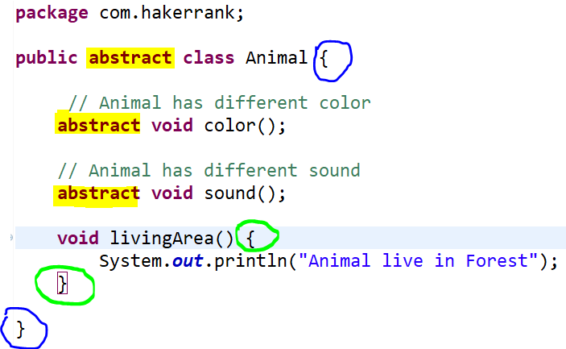
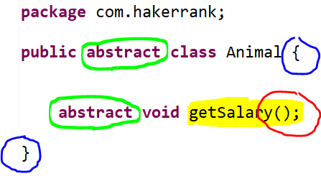
Code : Abstract class & Abstract method
Abstract word - in abstract class & abstract method
No description or { } in Abstract method
Abstract method must end with semi colon (;)
Here only class { } = blue color
Abstract class can also contains concrete method

Slide 22
Abstract like incomplete
Both Abstract class and abstract method –
Seems like incomplete
So must be complete those
How ? –
Abstract class extends Another class
Abstract method need to add description & complete in another class

Slide 23
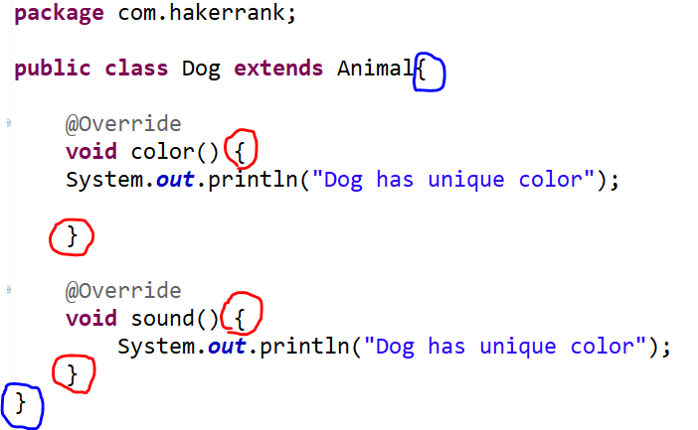
Abstract class must extends or inheritance to Another class
No Abstract word in class / method after inheritance
Only abstract method need to override or complete in new Dog class
Method has now { } = method description
We can add Dog color or sound inside method now

Slide 24
Abstract word in Java
Abstract word in method – if method has no description- mean no { }
Abstract in class – if a class contains at least one abstract method
Both Abstract class & method must be inheritance or extends to Another class
After inheritance or extends - if all abstract method override than no more abstract word in class
After inheritance or extends - if all any method not override than use abstract word in class

Slide 25
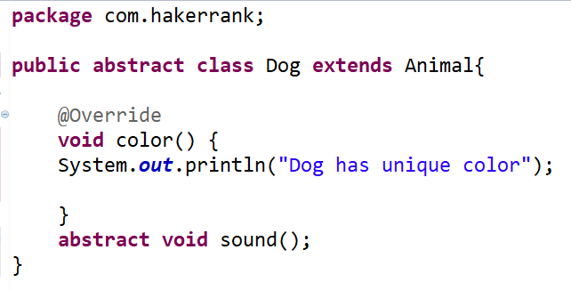
After inheritance or extends - if all abstract method override than no more abstract word in class After inheritance or extends - if all any method not override than use abstract word in class

Slide 26

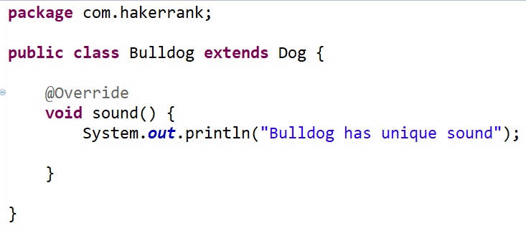
Dog class is abstract as sound method is abstract Bulldog is concrete class as no more abstract methods

Slide 27
Inheritance or extends word in JAVA
Inheritance is a part of java OOPs
OOPs (object oriented programing)
OOPs contains –
Inheritance
Encapsulation
Polymorphism
Abstraction
OOPs understanding must need for any QA or developer

